Slide 1
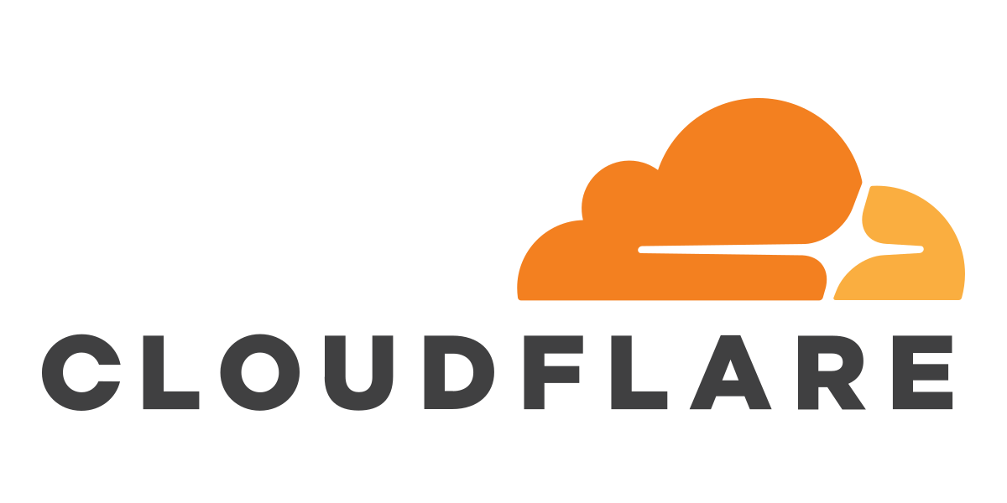


Might I Get Pawned:
A Second Generation Compromised Credential Checking Services
Bijeeta Pal, Mazharul Islam, Marina Sanusi, Nick Sullivan, Luke Valenta, Tara Whalen, Christopher Wood, Thomas Ristenpart, Rahul Chattejee
Notes:
Add other affliations

Slide 2
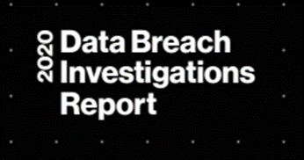
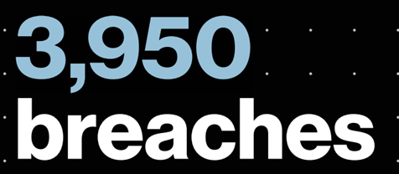



Motivation of Compromised Credential Checking Services

Slide 3





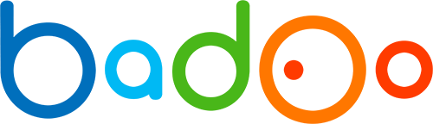

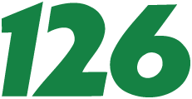








Motivation of Compromised Credential Checking Services

Slide 4
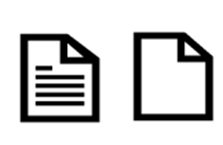

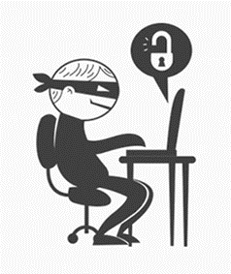


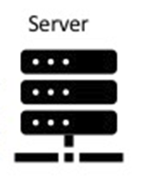
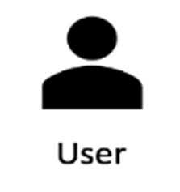


Motivation of Compromised Credential Checking Services
$(Alice, spiderman)$
Credential Stuffing attack
Breach Passwords
Compromised Credential Checking Services
Password Reset Request
$(Alice, spiderman123)$
Your password has been leaked!
Notes:
Just to give a mor
e concrete idea ….. Automatically anitmate
(add u, w)

Slide 5
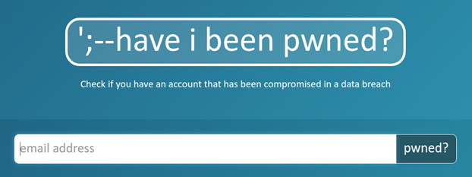
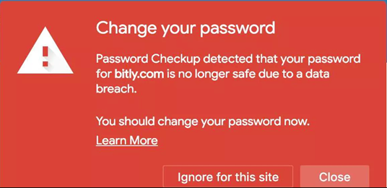
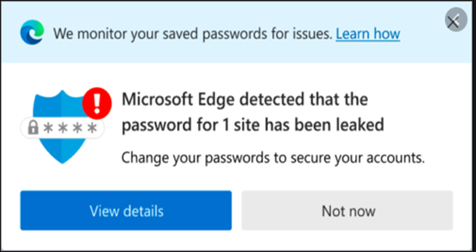
Popular Breach Altering Services
Have I Been Pwned?
Google Password Checkup
Password Monitor

Slide 6

Motivation of Compromised Credential Checking Services
$(Alice, spiderman123)$
Building a compromised credential checking services to stop credential tweaking attack
Breach Passwords
Credential Tweaking attack works because users choose similar passwords across different websites [1, 2]
Credential tweaking attacker can compromise 16% of user accounts that appear in a breach in less than a thousand guesses [3]
[1] DAS, A., BONNEAU, J., CAESAR, M., BORISOV, N., AND WANG, X. The tangled web of password reuse. In NDSS (2014), vol. 14, pp. 23–26.
[2] ANG, D., ZHANG, Z., WANG, P., YAN, J., AND HUANG, X. Targeted online password guessing: An underestimated threat. In Proceedings of the 2016 ACM SIGSAC conference on computer and communications security (2016), ACM, pp. 1242–1254
[3] ] PAL, B., DANIEL, T., CHATTERJEE, R., AND RISTENPART, T. Beyond credential stuffing: Password similarity using neural networks. IEEE Symposium on Security and Privacy (2019)
Notes:
Just to give a more concrete idea ….. Automatically anitmate
Mention the third paper introduced CT attack.
Cite the paper at the bottom and mention the point in the slide.

Slide 7
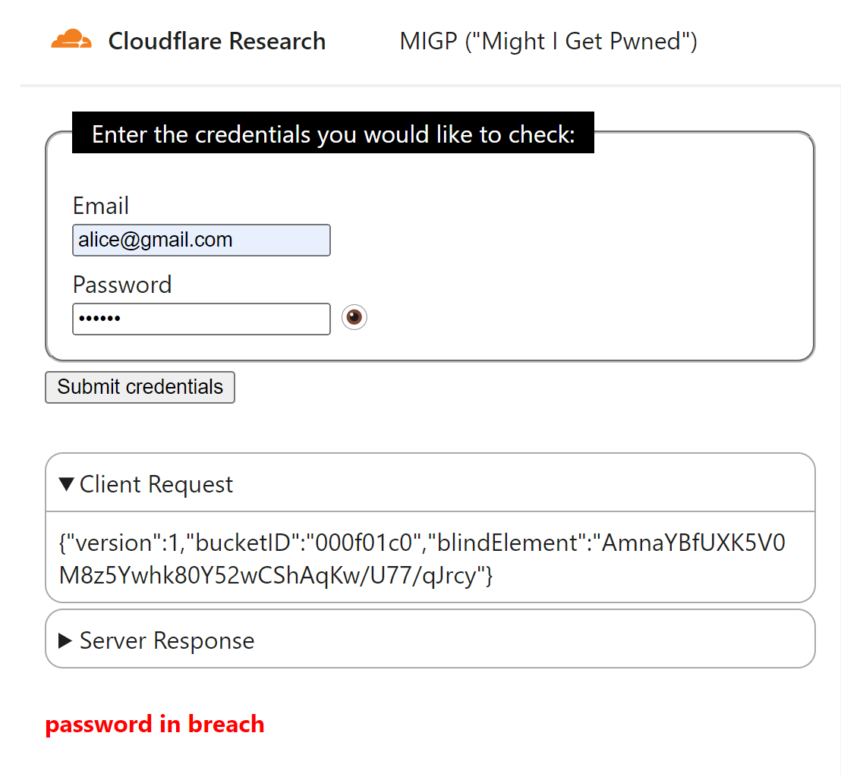
MIGP ("Might I Get Pwned")
Challenges
Designing similarity measure for two passwords
Preventing attacker from extracting privately leaked password?
Handling latency for massive size breach password?
Notes:
Add a video demo here… like Davd did.
Remove the demo right side here…
T

Slide 8
MIGP ("Might I Get Pwned")
Challenges
Designing similarity measure for two passwords
Preventing attacker from extracting privately leaked password?
Handling latency for massive size breach password?
Notes:
Add a video demo here… like Davd did.
Remove the demo right side here…
T

Slide 9


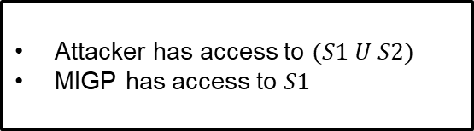


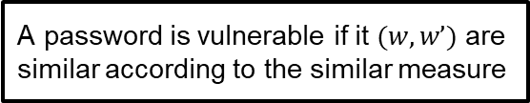
Designing similarity measure for two passwords
Breach Dataset
1.3 Billion <user-pw pair>
Training Dataset (80%)
Training Dataset $(S1$)
Attacker has access to $(S1 U S2)$
MIGP has access to $S1$
Test
Dataset
(20%)
Training Dataset $(S2)$
Similarity measures
Das-R
wEdit
P2P
PPSM
A password is vulnerable if it $(w,w’)$ are similar according to the similar measure
Notes:
The training datasets

Slide 10
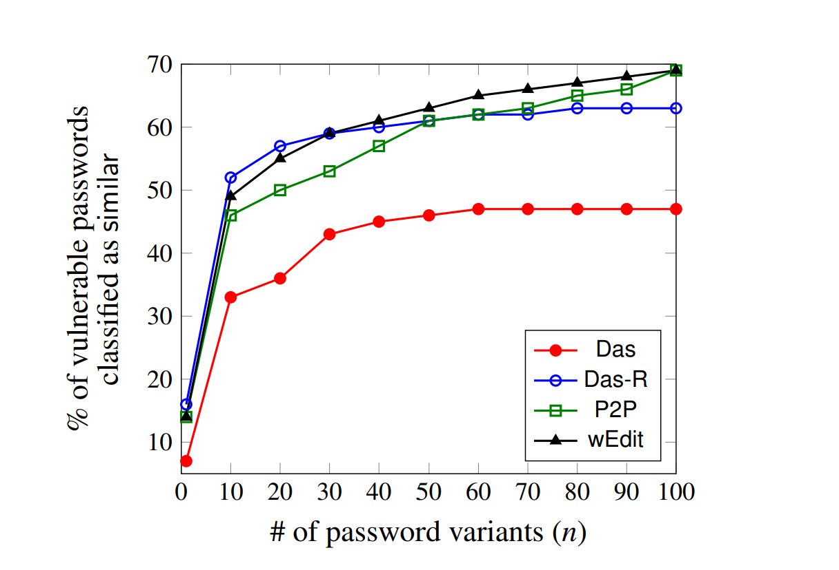
Designing similarity measure for two passwords (cntd)
Slopes for all similarity measure decrease rapidly after n > 10
Das-R has the can explain a maximum of 52.6% similar passwords chosen by users
Notes:
It was surprising to us that the rule-based approaches (Das-R,wEdit) end up matching or exceeding the performance of the much more complex deep learning approach underlying P2P.
This is because rule-based approaches can easily capture frequently seen variants, for low values of n. The deep learning approach works better for large n by finding and ordering less frequently seen similarity relationships. For example, for n = 103 , P2P outperforms wEdit by 4%.

Slide 11
MIGP ("Might I Get Pwned")
Challenges
Designing similarity measure for two passwords
Preventing attacker from extracting privately leaked password?
Handling latency for massive size breach password?
Notes:
Add a video demo here… like Davd did.
Remove the demo right side here…
T

Slide 12
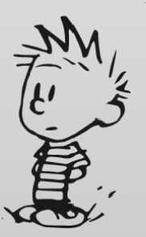
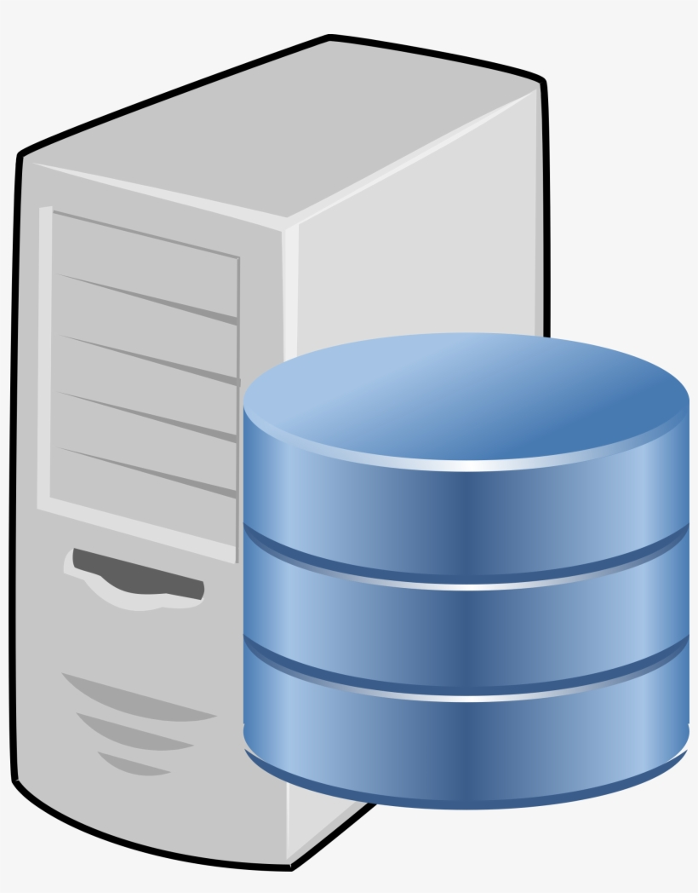

Traditional Threat model: Malicious Server
Public Leaked Dataset
Client
MIGP Server

Slide 13
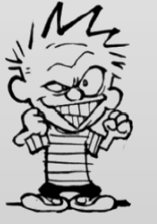
New Threat Model: Malicious Client
Leaked Dataset
Can be private
Breach Extraction attack
Client
MIGP Server
Notes:
Threat model requirements.
Server side → OPRF based protocol
Client side → Security loss show here.. Malicious client…..
Security loss.
Similarity rules
Performance simulation.

Slide 14
Improved Threat Model: Malicious Client
Leaked Dataset
Can be private
Breach Extraction attack
Client
MIGP Server
Notes:
Threat model requirements.
Server side → OPRF based protocol
Client side → Security loss show here.. Malicious client…..
Security loss.
Similarity rules
Performance simulation.

Slide 15
Improved Threat Model: Malicious Client
Leaked Dataset
Can be private
Breach Extraction attack
Client
MIGP Server
Notes:
Threat model requirements.
Server side → OPRF based protocol
Client side → Security loss show here.. Malicious client…..
Security loss.
Similarity rules
Performance simulation.

Slide 16
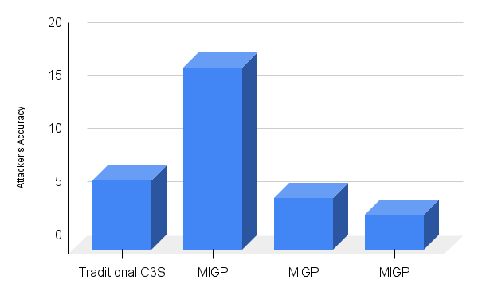
Improved Threat Model: Malicious Client
Blocklisting 10^4 popular passwords
Rate limiting the client to 100 queries
Baseline

Slide 17
Improved Threat Model: Malicious Client
Block-listing 10^4 popular passwords
Rate limiting the client to 100 queries
Baseline

Slide 18
Improved Threat Model: Malicious Client
Block-listing 10^4 popular passwords
Rate limiting the client to 100 queries
Baseline

Slide 19
Challenges
Designing similarity measure for two passwords
Preventing attacker from extracting privately leaked password?
Handling latency for massive size breach password?

Slide 20
Conclusion
Naïve handcrafted tweaking rules wEdit, Das-R outperforms powerful Deep Learning based tweaking rules for small tweaks.
Block-listing and rate limiting the client can motivate companies to share their private leaked Dataset to MIGP
MIGP ("Might I Get Pwned")
Similarity Rules
Breach Extraction Attack
Future work
Our Breach Extraction is not optimal.
Our Protocol is relatively Naive.

